Slide 1
RFM Segmentation
Hotel Customer
Urfi Yogabama
04 July 2023

Slide 2
Overview
Hotel Marketing Team want to know their customer segmentation through RFM Segmentation so they know how to the treat their customer.
Summary
There are 4 segments that has been made, they are Royal, Current, Absent, and Sleeping customer.
Actions:
1. Create loyalty program for all customers with 4 different levels for each segments.
2. Emphasize reach out campaign on sleeping customer.
3. Give Absent and Current customer Bundled product with discount.
4. Give Royal customer Bundled product with discount or cashback (since Royal customers will use cashback).
Scope and Goals
- Create user segmentation for the Hotel customer
- Analysis user behaviour based on the segmentation
- Create action recommendation for each segment
Methodologies
1. Business Understanding
2. Data Preparation and Cleaning
3. Data Analysis and Modeling
4. Data Visualization
5. Recommendation

Slide 3
The Data
https://www.sciencedirect.com/science/article/pii/S2352340920314645?via%3Dihub

Slide 4
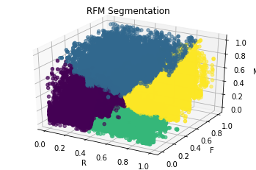
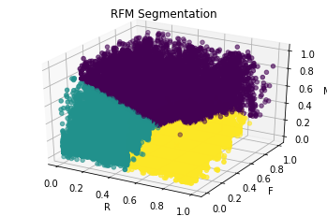
RFM Segmentation
Point plot of every transaction in normalization
Segmentation:
: Royal Customer
: Current Customer
: Absent Customer
: Sleeping Customer

Slide 5
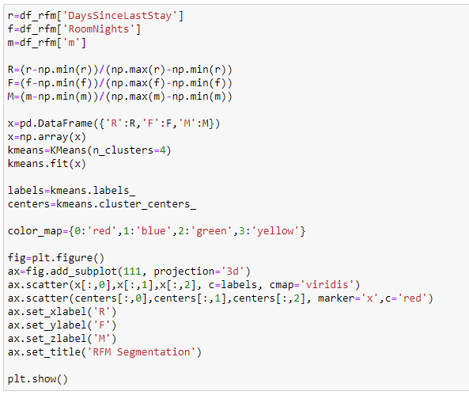
RFM Segmentation Python Code
Using K-means
There are four clusters

Slide 6
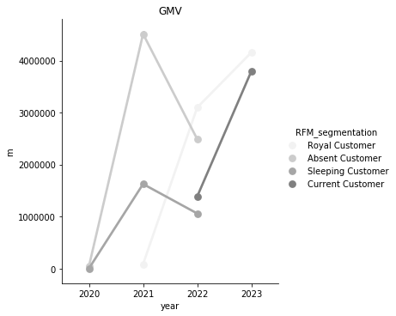
GMV
In the recent year, Royal customer is the biggest GMV.
Working on Absent customer that ever give high GMV is worth it.

Slide 7
GMV Python Code

Slide 8
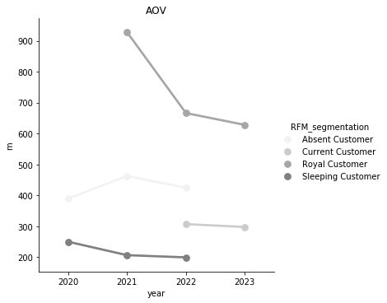
AOV
AOV of Royal customer is the highest throughout the year.
Working on Absent customer will may lead to improve AOV since it has already given big AOV in the past.

Slide 9
AOV Python Code

Slide 10
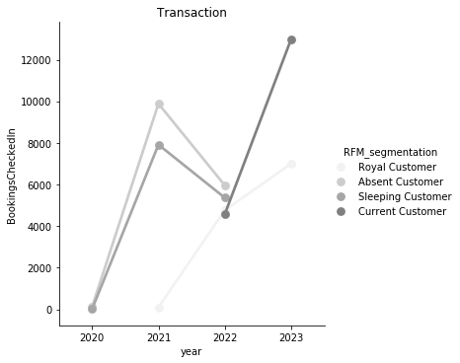
Transaction
In the recent year, current customer has the biggest Transaction.
Working on the royal customer for making more transaction will be good since it will increase revenue.

Slide 11
Transaction Python Code

Slide 12
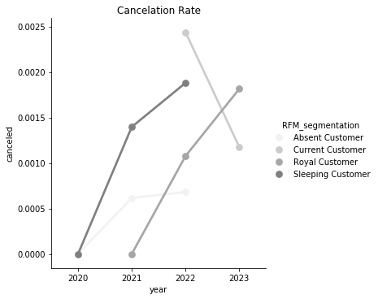
Cancelation Rate
Cancelation rate by Current customer is the lowest nowadays. However, Royal customer is the highest
The absent customer and sleeping do not do transaction in this year, so they do not have cancelation rate in this year.

Slide 13

Cancelation Rate Python Code

Slide 14
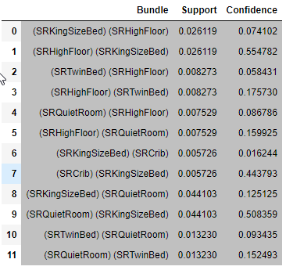
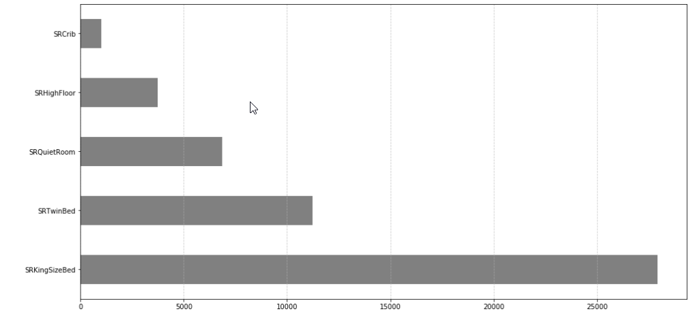
Bundle
The bundle is combination of 5 topmost product

Slide 15
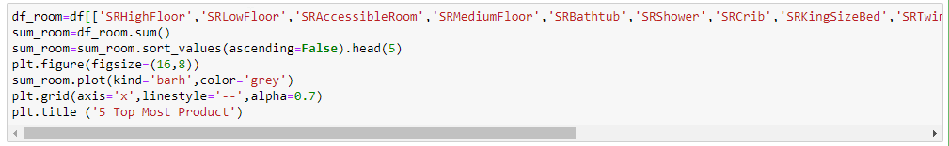
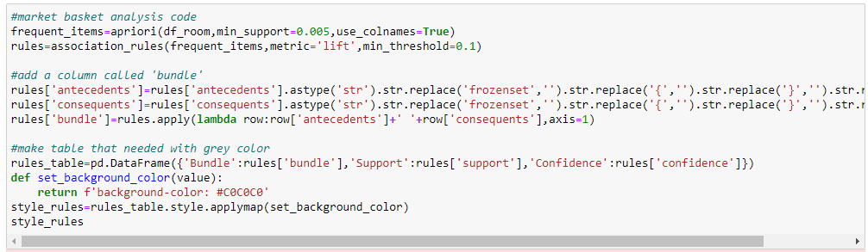
5 Top Most Products Python Code
Bundle Python Code

Slide 16
RFM Segmentation
 | Current Customer | Royal Customer | Absent Customer | Sleeping Customer
Number of Customer | 17242 | 11336 | 15776 | 13211
Recency | 248 days | 317 days | 793 days | 777 days
Frequency | 2 or 3 people | 4 or 5 people | 3 or 4 people | 1 or 2 people
Monetary | 5,171,645.29 Euros | 7,324,588.64 Euros | 7,066,545.02 Euros | 2,689,547.33 Euros
AOV | 299.9 Euros | 646.1 Euros | 447.9 Euros | 203.6 Euros
Cancelation Rate | 0.15% | 0.15% | 0.06% | 0.16%

Slide 17
Recomendation
 | Current Customer | Royal Customer | Absent Customer | Sleeping Customer
Discount/Cashback | Discount for 1,2, or 3 people booking | Cashback for 1 to 5 people booking | Discount for 1 to 3 people booking | Discount for 1 or 2 people booking
Validity discount period | 1 month | lifetime | 3 months | 2 months
Bundle | SAME

Slide 18
THANK YOU!

